Slide 1

Happy Fox – UI &UX Project Status Presentation
Future Concept of the SRH
Akshata Naik
Chinmayee Joshi
Fragkiadakis Andreas
Sahana Nayaka Govindappa Premakumari
Notes:
Hello everyone
My name is
we worked on this prj in the last 4-5 weeks

Slide 2
Table of
Contents
01.
02.
03.
04.
Our team & topic introduction
Req. Analysis
Project design with HTML/CSS
References
Why was this project created in the first place? What are the needs of the users?
Showcase of the main parts of our project, our goal as a group and innovative ideas
All the sources of our knowledge and shared information.
Learn who we are, and what we are working on.
Notes:
Getting to the table of contents, here is a brief overview of the aspects we are going to discuss today,
Including our group presentation, problem analysis from a users standpoint, some use cases, and much more.

Slide 3
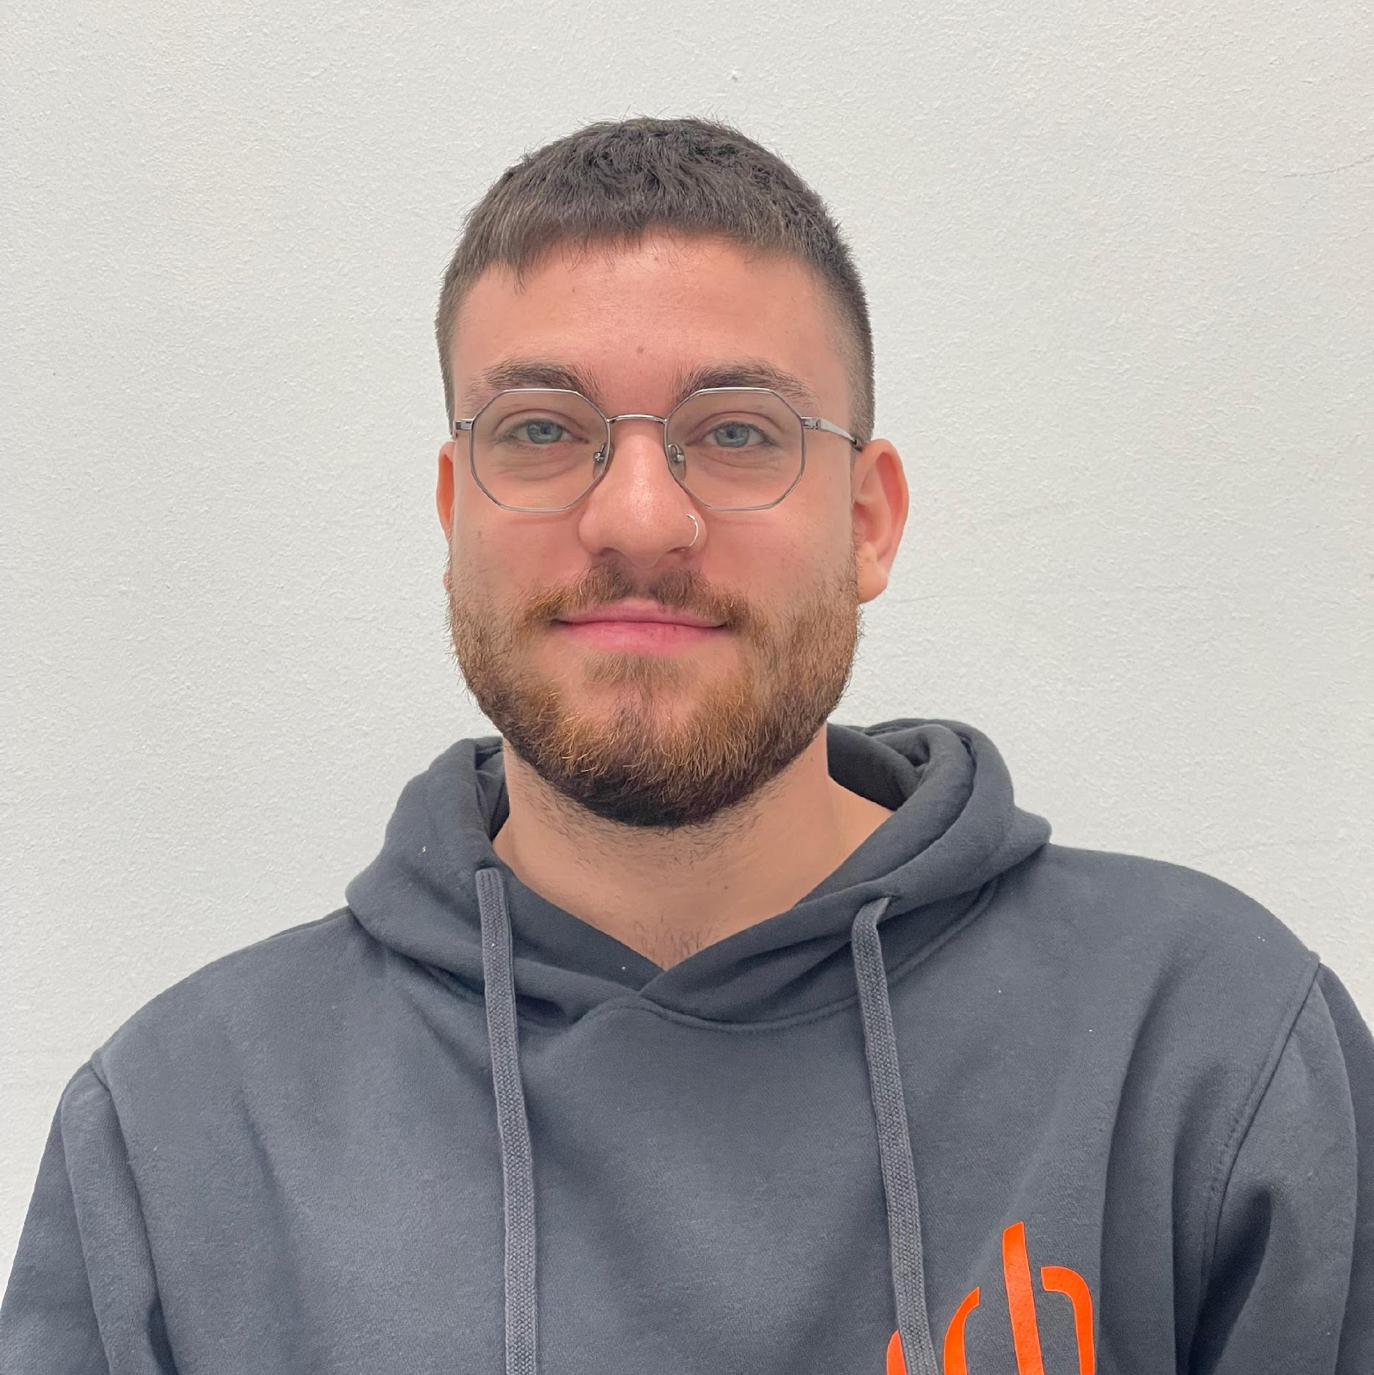
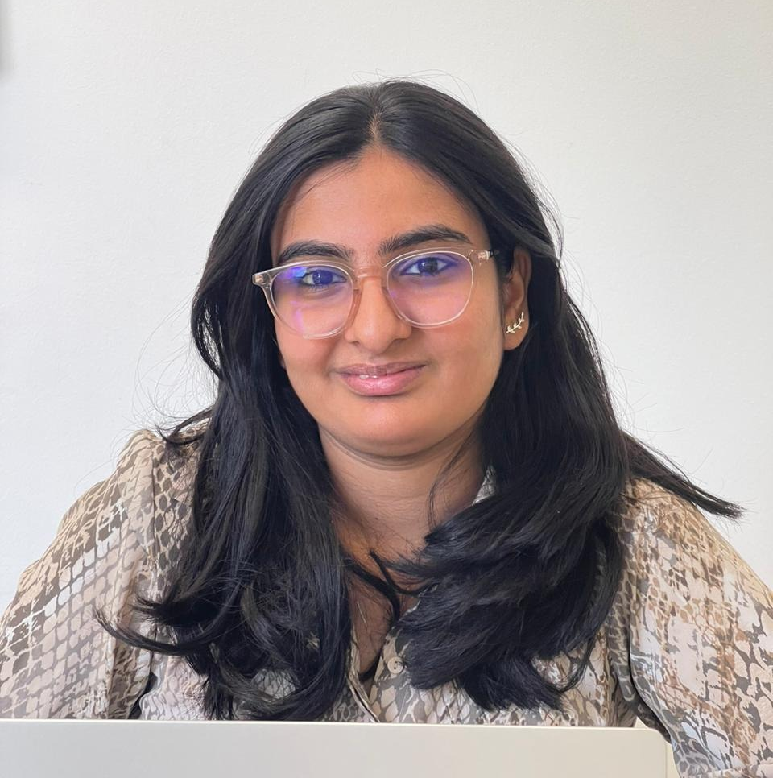
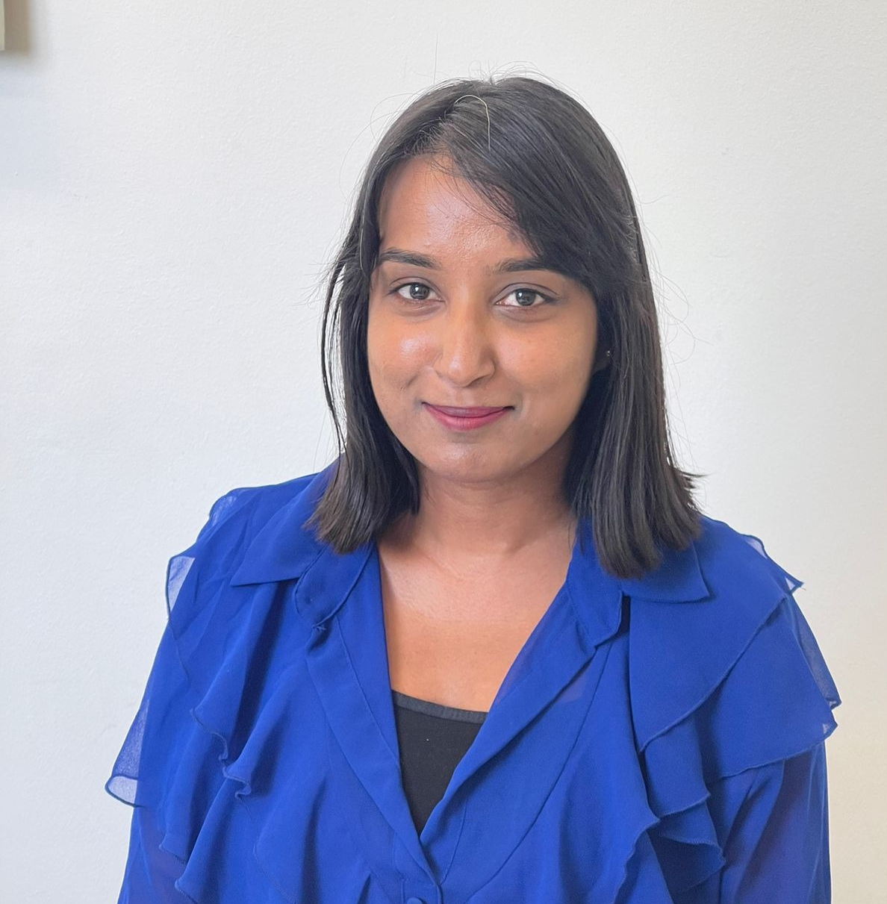
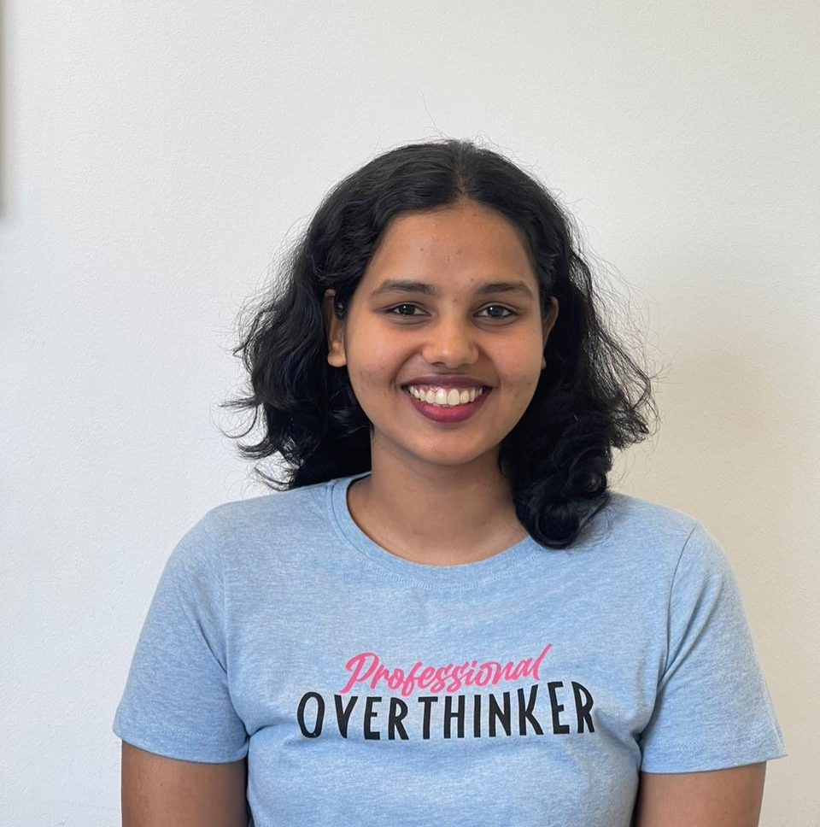
1. Our Team
Fragkiadakis, Andreas
Chinmayee
Joshi
Sahana Nayaka Govindappa Premakumari
Akshata
Naik
Notes:
This is our team,

Slide 4
1. The Topic: Understanding the topic and its importance.
Notes:
Now we get to the problem and see it closely as a user.

Slide 5
Mental Health: An Essential Part of Our Overall Well-being
💭 Mental health includes our emotional, psychological, and social well-being
🧠 Affects how we think, feel, and act
🤔 Determines how we make choices and handle stress
❤️ Taking care of our mental health is important for our overall health and well-being
💪 Seeking help when we need it is a sign of strength
Notes:
Initial q&a:
By that, WE MEAN the questions they get from the medical staff in order to get assistance, which is confusing especially for elderly people and time consuming for both parties.
These are challenging problems faced by both Heidelberg Clinic and patients on a daily basis, emphasizing that it is a significant issue that affects everyone.

Slide 6
2. Analysis: Examining and investigating the task.
Notes:
Now we get to the problem and see it closely as a user.

Slide 7
2.1 Requirement analysis: Researching into the problem from a user‘s perspective.
Notes:
Now we get to the problem and see it closely as a user.

Slide 8
User Research
Categories of users:
User expectations & features based on our research survey
Youth
Mid aged - Adults
Veterans - Senior Citizens
Easy to use - access the features, view the progress
Setting personalized goals
Stress management
Self-care reminders
Journals and affirmations
Notes:
Initial q&a:
By that, WE MEAN the questions they get from the medical staff in order to get assistance, which is confusing especially for elderly people and time consuming for both parties.
These are challenging problems faced by both Heidelberg Clinic and patients on a daily basis, emphasizing that it is a significant issue that affects everyone.

Slide 9
Stakeholder Analysis
Stakeholders include:
Investors
Product Owners
Project managers
Users/Testers
Development team
Health/fitness professionals
Notes:
Initial q&a:
By that, WE MEAN the questions they get from the medical staff in order to get assistance, which is confusing especially for elderly people and time consuming for both parties.
These are challenging problems faced by both Heidelberg Clinic and patients on a daily basis, emphasizing that it is a significant issue that affects everyone.

Slide 10



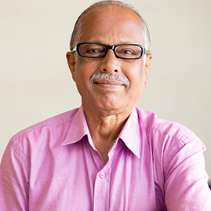
Personas
Fabian
Software Engineer,
Age 30
Anna
Immigrant University Student, Age 19
Emily
Housewife,
Age 38
Alex
Veteran Senior Citizen,
Age 65
Notes:
This is our team,

Slide 11
2.2 The POVs: Understanding the points of view, from the users side.

Slide 12


The POVs Description
Fabian:
Anna:
I need a mental health app that reminds me to take short breaks during work.
I'm looking for resources in the app to manage stress caused by high-pressure deadlines and excessive workload.
I would like self-care reminders and suggestions tailored to my preferences and interests.
I want stress management techniques to cope with the challenges of adjusting to a new culture and language.
I need calming exercises and activities in the app to manage anxiety.
I want to connect with others facing similar challenges through community forums or support groups within the app.

Slide 13

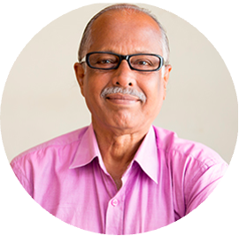
The POVs Description
Emily:
Alex:
I need a mental health app that offers relaxation techniques like guided meditations and breathing exercises to help me prioritize self-care.
I want access to resources that help me find moments of relaxation and self-care during my busy day, such as quick self-care activities or mini-break suggestions.
I seek mental health resources designed for seniors, promoting overall well-being.
I would like to connect with support groups for older adults and share experiences for emotional support.
I'm interested in mindfulness exercises and practices within the app to promote relaxation and emotional well-being.

Slide 14
2.3 MoSCoW Analysis Feature prioritization for our mental health app.

Slide 15
The POVs Description
Must-Have:
Should-Have:
Could-Have:
Relaxation techniques: Provide a variety of guided meditations, breathing exercises, and progressive muscle relaxation to help users relax and manage stress effectively.
Stress reduction techniques: Offer stress-reducing exercises to assist users in identifying and managing stress triggers.
Self-care reminders: Implement a reminder system for users to engage in self-care activities, such as hydration breaks,, exercise etc.
Daily goals & journal: Allow users to set daily mental health goals and provide a journaling feature for reflection and progress tracking.

Slide 16
3. The Project design (HTML/CSS)

Slide 17
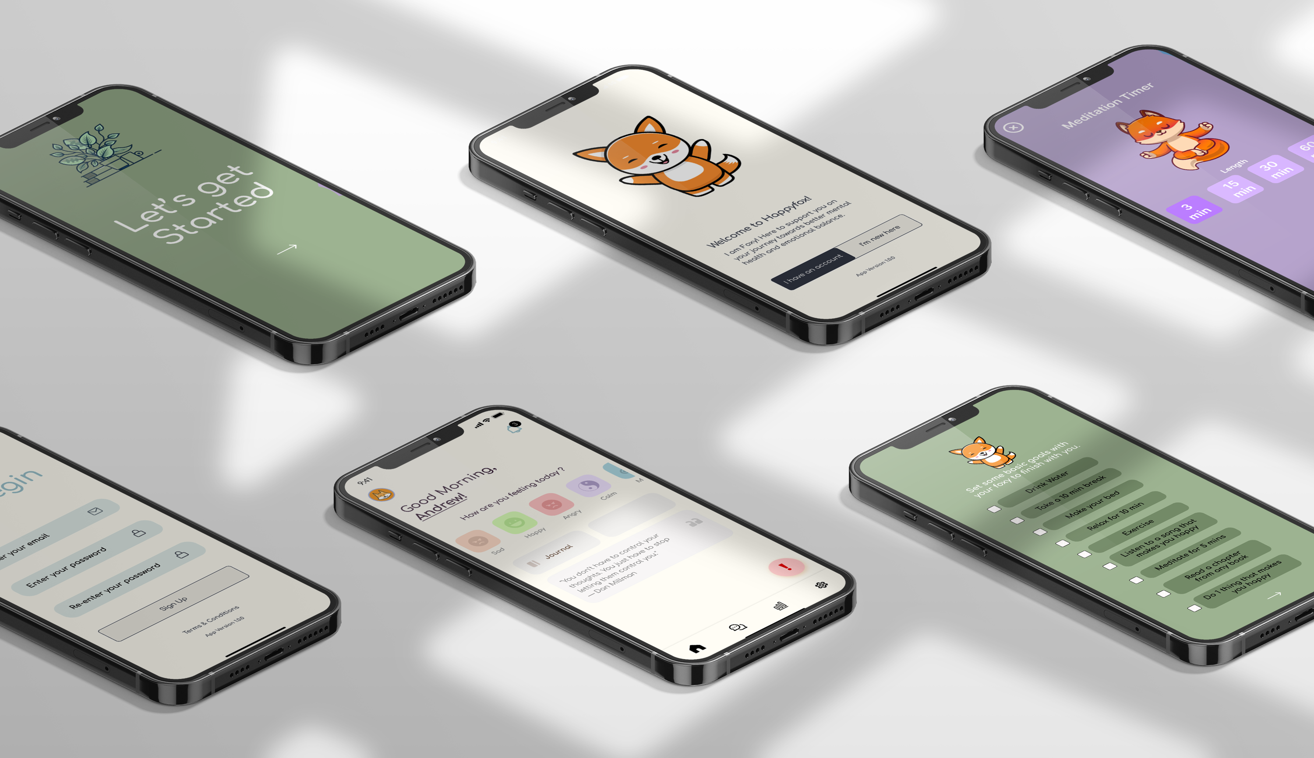
Designed Frames/Work in Progress

Slide 18
References
Guberman, S. (2017). Gestalt Theory Rearranged: Back to Wertheimer. Frontiers in Psychology, 8. https://doi.org/10.3389/fpsyg.2017.01782
Plumptre, E. (2023). The importance of mental health. Verywell Mind. https://www.verywellmind.com/the-importance-of-mental-health-for-wellbeing-5207938
Babich, N. (2020, May 12). 5 Essential UX Rules for Dialog Design - UX Planet. Medium. https://uxplanet.org/5-essential-ux-rules-for-dialog-design-4de258c22116
What is Usability Engineering? (2017, June 21). The Interaction Design Foundation. https://www.interaction-design.org/literature/topics/usability-engineering
De Mendonça Lima, C. A. (2013, 1 September). Mental health and Wellbeing of Older people: Opportunities and challenges. PubMed Central (PMC). https://www.ncbi.nlm.nih.gov/pmc/articles/PMC3822658/
Notes:
Here are some referances that were used to get information about our project

Slide 19
Questions?
?
Notes:
PROEJCT MANAGEMENT:
This is the practice of initiating, planning, executing, controlling, and closing a project in order to achieve specific goals and meet specific success criteria.
Two aspects of the magic triangle of project management: The "magic triangle" of project management consists of three interconnected factors: TIME, COST, and RESULT.
The two aspects of the magic triangle are that changes in one factor will affect the other two, and that a balance must be struck between the three factors to ensure project success.
1st and 2nd GOLDEN RULES:
„Put everything on paper“ „Written Form“ „Documentation“
Understand the business goals of your customer“
Project description: This is a document that outlines the key aspects of a project, including its objectives, scope, stakeholders, and timeline.
IT lifecycle: This refers to the stages of a software or IT project, including planning, development, testing, deployment, and maintenance.

Slide 20
Thank you for your time!
Notes:
If you have any more questions or would like to know even more details about our project,
I will give you a few seconds to scan this QR code which links to our full project report.

